Slide 1

ScamScan
AI-Powered Fake Website Detection
Capstone Project
Name: Gumpu UshaSri
Text, Web & Social Media Analytics
Reg. Number: 24MBMB36
Domain: E-commerce & Delivery
Course: MBA - Business Analytics
Year: 2024-2026

Slide 2

Project Overview
Scam Website Detection
Multi-faceted Analysis
Real-time Integration
Combines Web Scraping, NLP, WHOIS lookup, and Machine Learning.
Instant detection capabilities delivered via FastAPI.
AI-driven identification of fraudulent e-commerce platforms.

Slide 3
Problem Statement
Rise in Fake Online Stores
Users Fall Prey to Scams
Proliferation of fraudulent e-commerce platforms imitating trusted brands.
Increasing instances of payment scams and phishing attacks targeting online shoppers.
Manual Verification is Difficult
Need for Automated Detection
Human-led processes struggle to keep pace with the scale and sophistication of new threats.
Critical demand for an accurate, real-time automated scam detection solution.

Slide 4
Motivation
E-commerce fraud increasing rapidly
High financial losses & data theft
The digital landscape sees a constant surge in fraudulent online activities.
Consumers and businesses face significant monetary and data security risks.
Many scam sites look visually real
Users need a quick "trust score" tool
Sophisticated tactics make it difficult for users to distinguish legitimate from fake sites.
A reliable and immediate mechanism is essential for users to assess website legitimacy.

Slide 5
Use Cases
Detecting Fake Online Stores
Preventing Payment Fraud
Safeguard financial transactions by detecting and blocking suspicious activities.
Identify and flag fraudulent e-commerce sites to protect shoppers.
Monitoring Deals & Promotions
Supporting Merchant Verification
Ensure legitimacy of offers and prevent consumers from falling for fake discounts.
Provide tools for users to verify the credibility of online merchants.

Slide 6
Technology Stack
Programming
NLP
ML
Python
spaCy, TextBlob
scikit-learn, RandomForest
Web
Hosting / API
Data Tools
BeautifulSoup, Requests
FastAPI, Uvicorn
pandas, numpy, tldextract, WHOIS

Slide 7








System Architecture
User Input
URL Preprocessing
Web Scraping
NLP & WHOIS Analysis
TF-IDF
ML Classifier
Prediction
FastAPI Output

Slide 8
Project Methodology
Phase 1: Data Creation & Feature Extraction
Phase 2: ML Model Training & Evaluation
Phase 3: API Creation & Deployment

Slide 9
Feature Engineering
URL Features
Domain WHOIS Features
Web Content + NLP Features
TF-IDF Text Features

Slide 10
NLP Techniques Used in ScamScan
Text Extraction & Cleaning
TF-IDF Vectorization
Extracts website text
Converts text to feature vectors
Lowercasing, symbol removal, normalization
Captures scam-related terms
Keyword-Based Lexical Analysis
Named Entity Recognition
Counts entities (ORG, PRODUCT, PERSON)
Detects scam-related words
Identifies lack of proper entities
Computes keyword scores

Slide 11
Why Advanced NLP Techniques Were Not Used
Topic Detection (LDA / Topic Modeling)
Sentiment / Emotion Analysis
Scam sites use neutral/promotional text
Inconsistent topics on fake sites
Sentiment scores don't indicate legitimacy
Minimal/random text on scam pages
"Positive" scam wording misleads models
Yields noisy, meaningless clusters
Behavioral NLP Analysis
Relevance to Scam Detection
Requires user interaction logs
Relies on URL patterns, domain age, keywords
System analyzes websites, not user behavior
Offers higher accuracy, faster inference
Not applicable to our approach

Slide 12

Machine Learning Model Used
Algorithm: Random Forest Classifier
Input Feature Vector: 47 Dimensions
Training Strategy
Train-test split for evaluation
Suitable for mixed feature types (URL + text + domain features)
URL structural features
Balanced dataset (real + synthetic scam URLs)
Handles high-dimensional TF-IDF vectors efficiently
Domain and WHOIS features
Evaluated using accuracy, precision, recall, and F1 score
Resistant to overfitting and noise
Text/NLP features
Produces stable and reliable predictions
TF-IDF vector
Features
Random Forest
Output: Legit / Fake

Slide 13
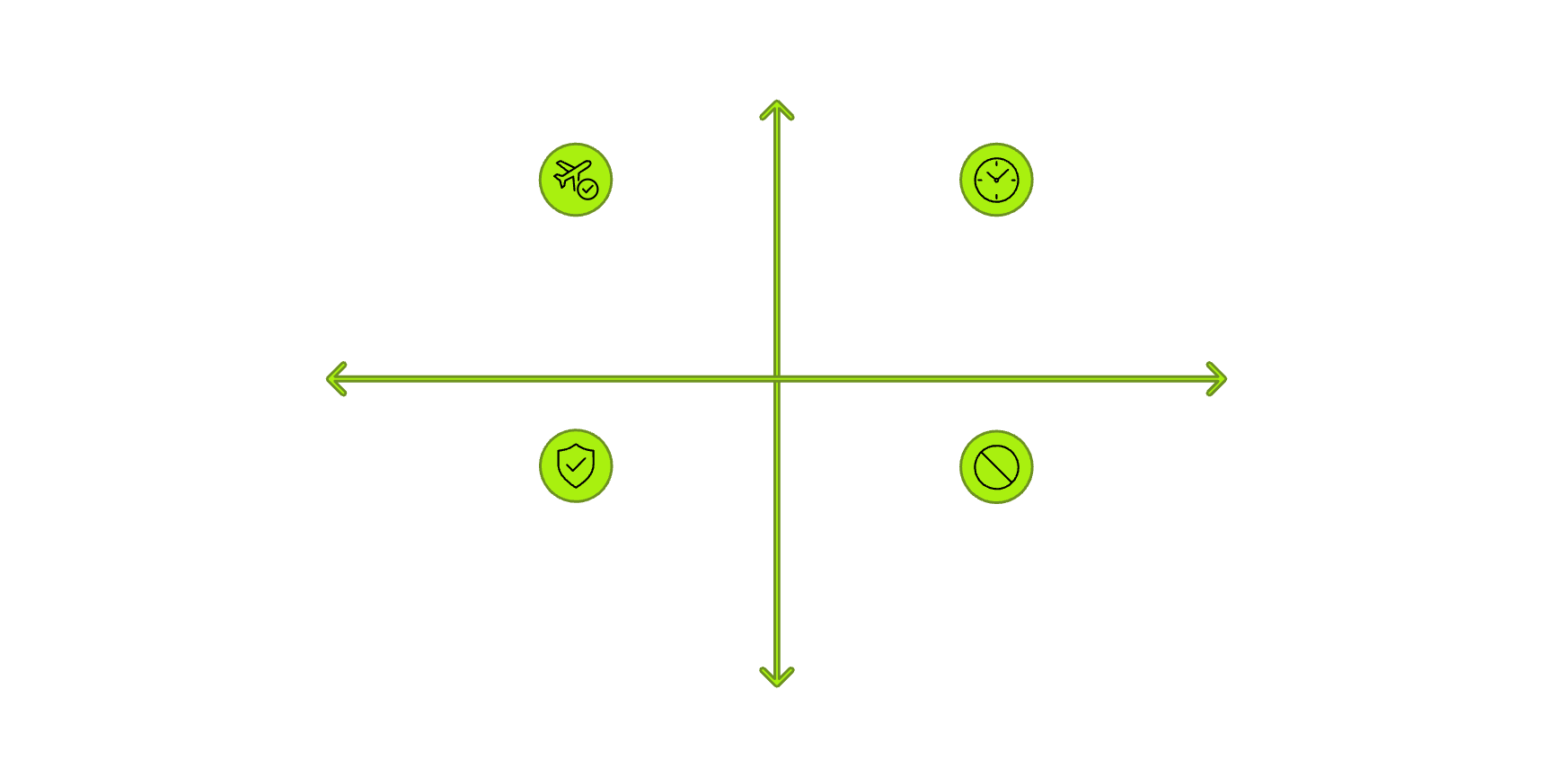
Model Performance & Evaluation
Accuracy
Actual: Positive
100%
True Positives(High/Perfect)
False Positives(0/None)
Precision
Predicted: Negative
Predicted: Positive
100%
True Negatives(High/Perfect)
False Negatives(0/None)
Recall
Actual: Negative
100%
F1 Score
100%

Slide 14





API Deployment – FastAPI
Backend Technology: FastAPI
Key Endpoints Implemented
Deployment Features
Lightweight and high-performance Python web framework
/predict → Fake vs. Legit website classification
Fast JSON responses
Ideal for real-time ML predictions
/payment-check → Detect risky payment patterns
Cross-platform use (web/app/browser extension)
Auto-generated Swagger documentation
/scan-promotions → Identify suspicious discounts or offers
Modular feature extraction + ML pipeline
/merchant-verification → WHOIS-based legitimacy check
/risk-score → Combined scam score (0–100)
/full-analysis → Complete scam intelligence report
Simple API Flow:
User Input URL
FastAPI
Feature Extraction
ML Model
Output Prediction

Slide 15
Challenges & Future Scope
Challenges Faced
Future Scope
WHOIS lookup failures or inconsistent responses
Integrate deep learning models (BERT, RoBERTa) for richer text understanding
Some websites block scraping or load via JavaScript
Limited publicly available scam datasets
Multi-language website analysis (Hindi, Telugu, Tamil, etc.)
Many scam websites have very little text or auto-generated content
Browser extension for real-time scam detection
Social media scam post detection (Instagram, WhatsApp, Telegram)
Balancing real vs. synthetic data
Mobile app for URL scanning and fraud prevention
Deploy API using AWS / GCP

Slide 16
Thank You

